Slide 1


CIS Y4 Introduction to the Careers Service
Stephen Smith
Careers Consultant
University of Strathclyde Careers Service
www.strath.ac.uk/careers
@StephenCareers

Slide 2
What are we here for?
Help you explore your options and decide on a career
Help you to make a plan to achieve your career goals
Help you to successfully apply to opportunities

Slide 3

Where are we?
Careers Service, L4, Jocelyn Bell-Burnell Wing, Learning & Teaching Building

Slide 4
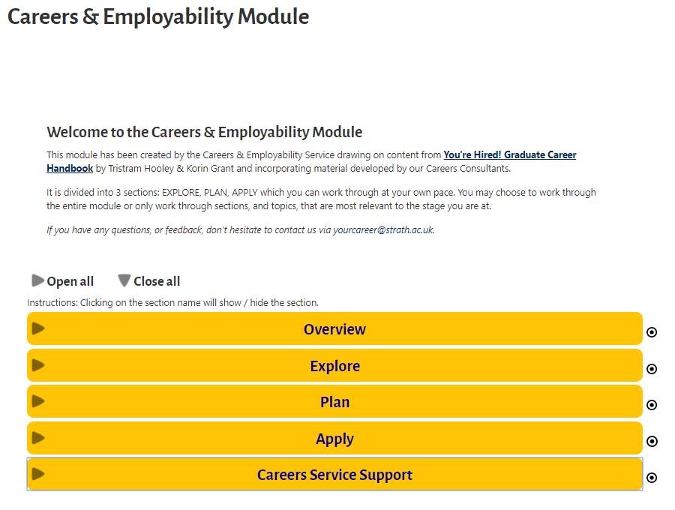
Resources – UG Careers Module
https://www.strath.ac.uk/professionalservices/careers/students/modules/undergraduatecareersmodule/

Slide 5
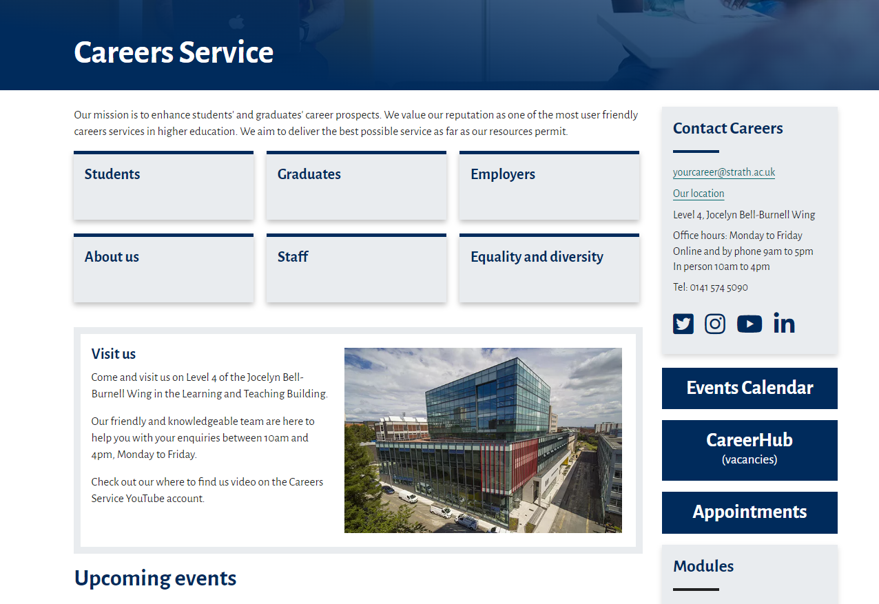
Resources – Careers Website
https://www.strath.ac.uk/professionalservices/careers/

Slide 6
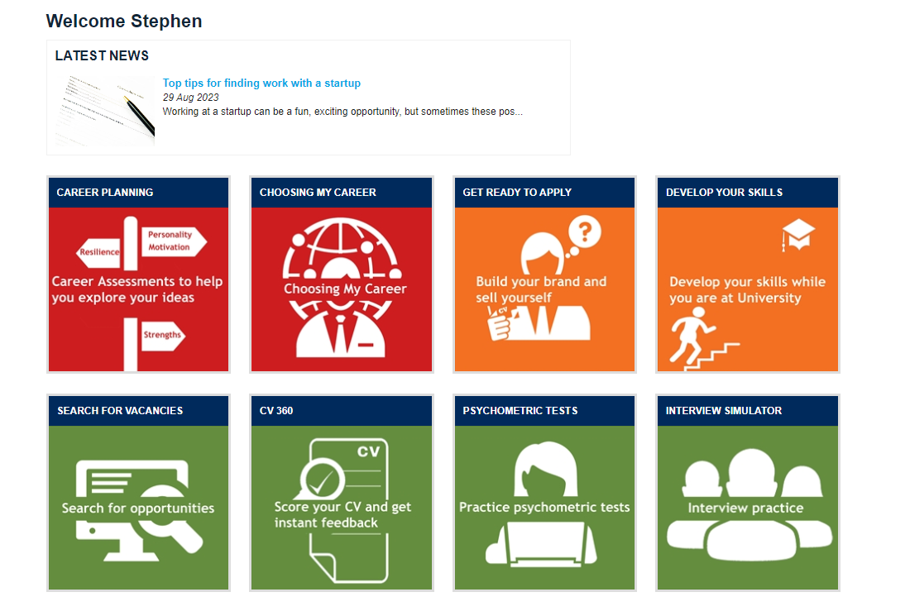
Resources – Careers Toolkit
https://www.abintegro.com/welcome/Strathclyde-University

Slide 7
Graduate Opportunities
Start searching now for graduate programmes/schemes
Careers Service Information & Resources: Looking for a Job https://www.strath.ac.uk/professionalservices/careers/students/lookingforajob/
Use our occupational resources ‘I want to work in…’ to help with your search https://www.strath.ac.uk/professionalservices/careers/students/choosingacareer/iwanttoworkin/
MyCareerHub Strathclyde (Vacancy Portal) https://careerhub.strath.ac.uk/students/login
Job search website for STEM students https://www.gradcracker.com/
Company Websites
Events Calendar https://careers.strath.ac.uk/Events

Slide 8



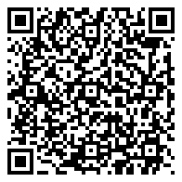

THE SCOTTISH
GRADUATE FAIR 2023
Date: 27 and 28 September 2023
Time: 11am to 4pm (each day)
Location: Technology and Innovation Centre (TIC), 99 George Street, Glasgow, G1 1RD
The Scottish Graduate Fair is the highlight of the recruitment season.
Now in its 34th year, it is the biggest graduate, postgraduate and internship recruitment event in Scotland attracting students and graduates of all disciplines and a variety of graduate employers and postgraduate recruiters.
More information at - www.scottishgraduatefair.org.uk
Scan here to register!
@ScotGradFair
#ScotGradFair23
Free to attend! Open to all Students & Graduates from all Universities.

Slide 9
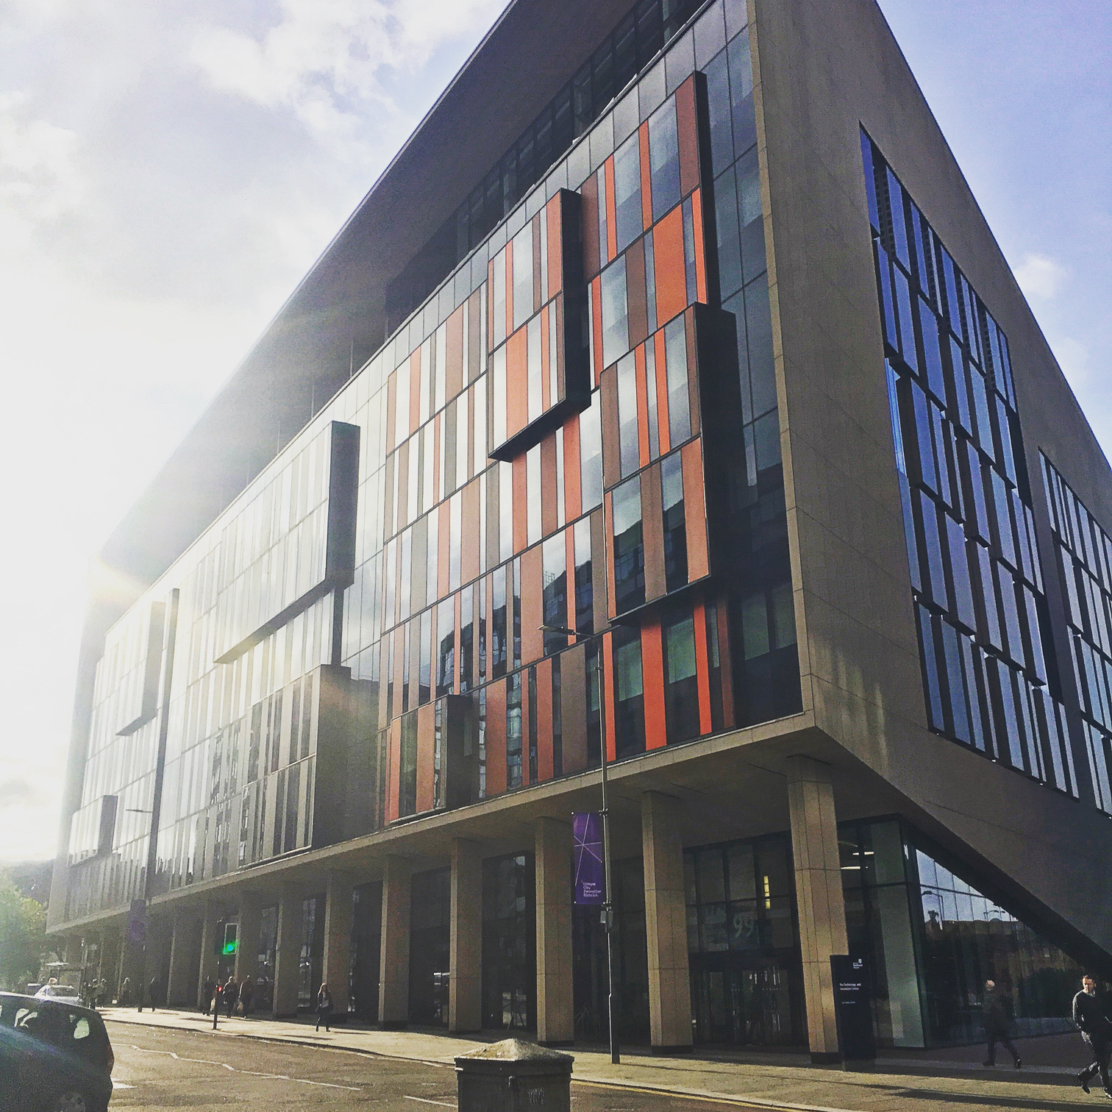

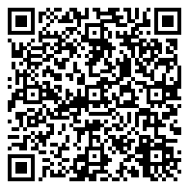

TECHNOLOGY FAIR 2023
Careers & Employability Service
Date: Thursday 9th November
Time: 1pm - 4pm
Location: Technology & Innovation Centre (TIC),
99 George Street, Glasgow, G1 1RD
The Technology Fair provides you with the opportunity to meet the leading tech firms who are looking to recruit from the University of Strathclyde and are offering internships and graduate roles.
This event is open to all students considering a career in IT and the tech industry.
Register NOW to attend!

Slide 10
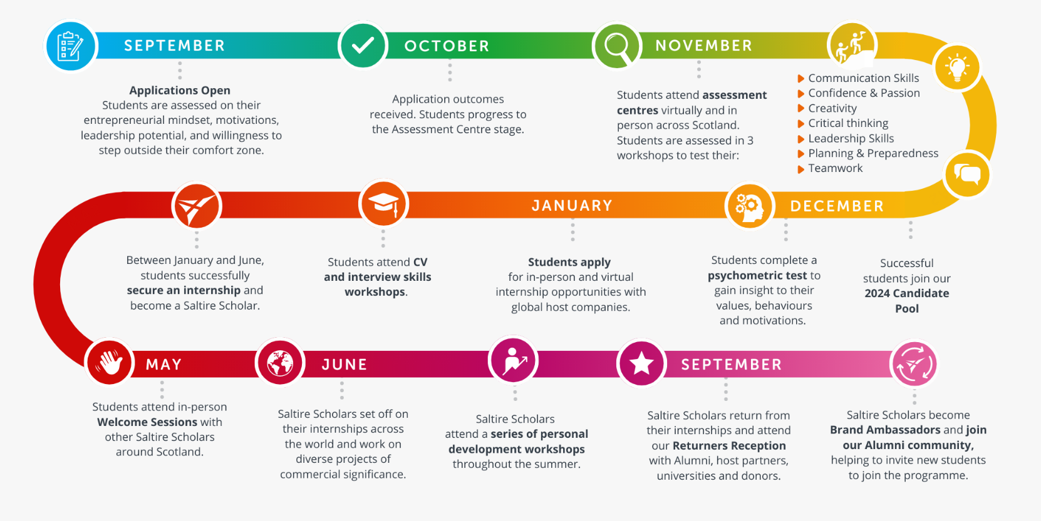
Saltire Scholar Programme
The Saltire Scholar Programme is open to all students in their penultimate or final year of study at a Scottish university. It is open to students from all degree backgrounds.
Register your interest - https://www.entrepreneurialscotland.com/programmes/saltire-scholar-programme/become-a-scholar
Saltire Scholar Information Session Information Session, 26 Sept (1pm-3pm)
http://tinyurl.com/4eyb22w9
Notes:
Timeline
Applications opening Monday 11th September.
Applications close Tuesday 3rd / Wednesday 4th October (4 weeks).
Application outcomes sent Monday 16th October.
Assessment Centre bookings open Wednesday 18th October.
Assessment Centres Mon 30th October – Fri 17th November (3 weeks).
Virtual Assessment Centres 20th, 21st, 22nd November.
AC outcomes sent by Friday 1st December.
First tranche of internships published January 2024.

Slide 11
Careers Service Support
Guidance Appointment 30 mins Book with Reception
Practice Interview 45 mins Book with Reception
CV Check 20 mins Book Online
Employer Events 1-2 hrs Book Online
Briefing Sessions 30 mins Book Online
Reception: Careers Service, L4, Student Experience, Learning & Teaching Building. Email yourcareer@strath.ac.uk

