Slide 1
CIS Y1 Introduction to the Careers Service
Stephen Smith
Careers Consultant
University of Strathclyde Careers Service
www.strath.ac.uk/careers
@StephenCareers

Slide 2
What are we here for?
Help you explore your options and decide on a career
Help you to make a plan to achieve your career goals
Help you to successfully apply to opportunities

Slide 3
Where are we?
Careers Service, L4, Jocelyn Bell-Burnell Wing, Learning & Teaching Building

Slide 4
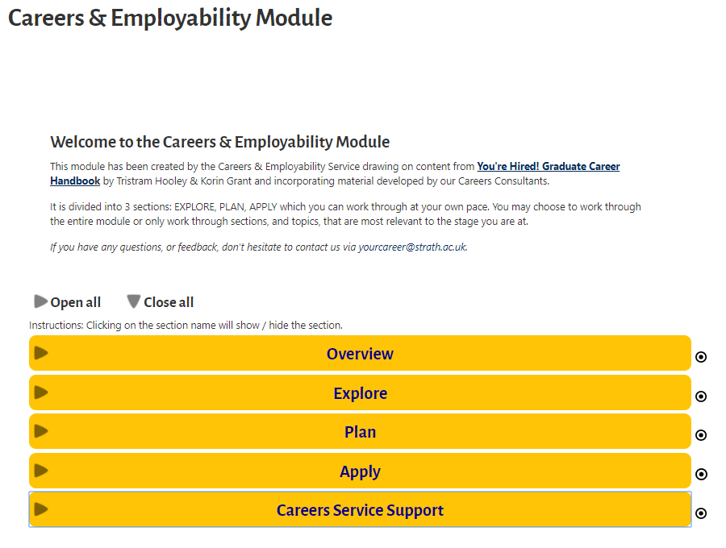
Resources – UG Careers Module
https://www.strath.ac.uk/professionalservices/careers/students/modules/undergraduatecareersmodule/

Slide 5
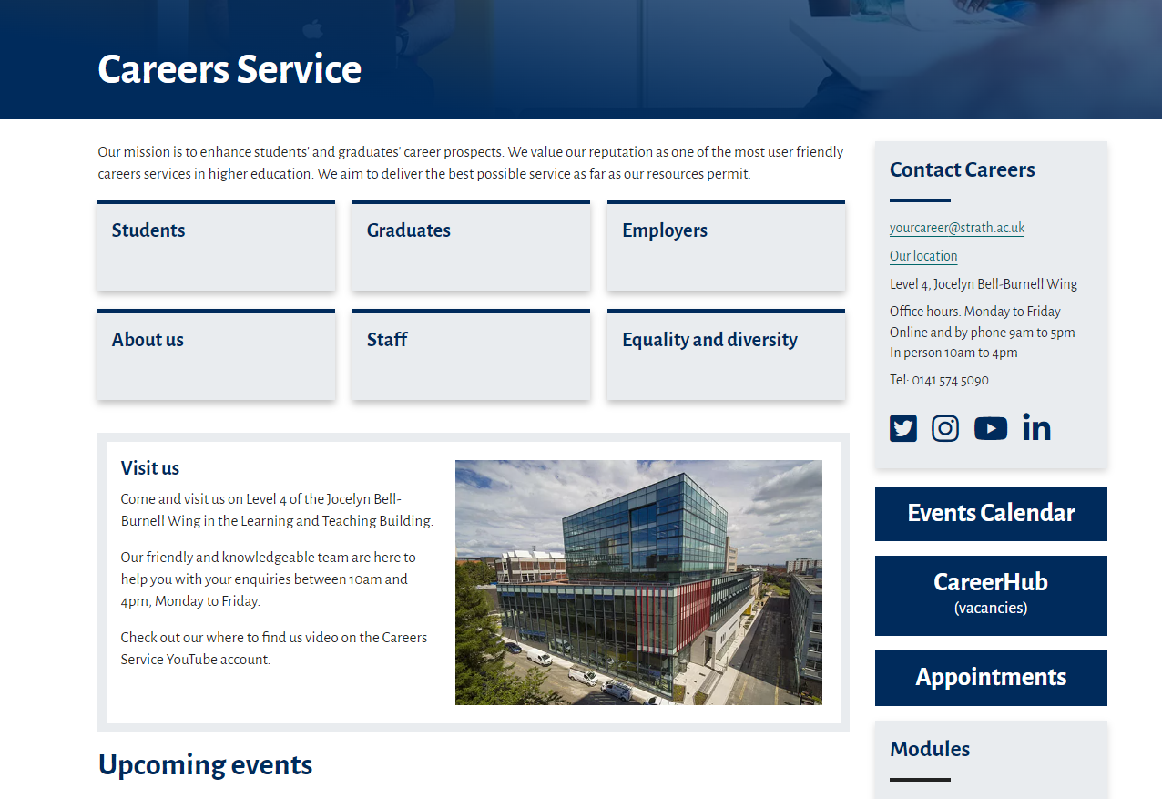
Resources – Careers Website
https://www.strath.ac.uk/professionalservices/careers/

Slide 6
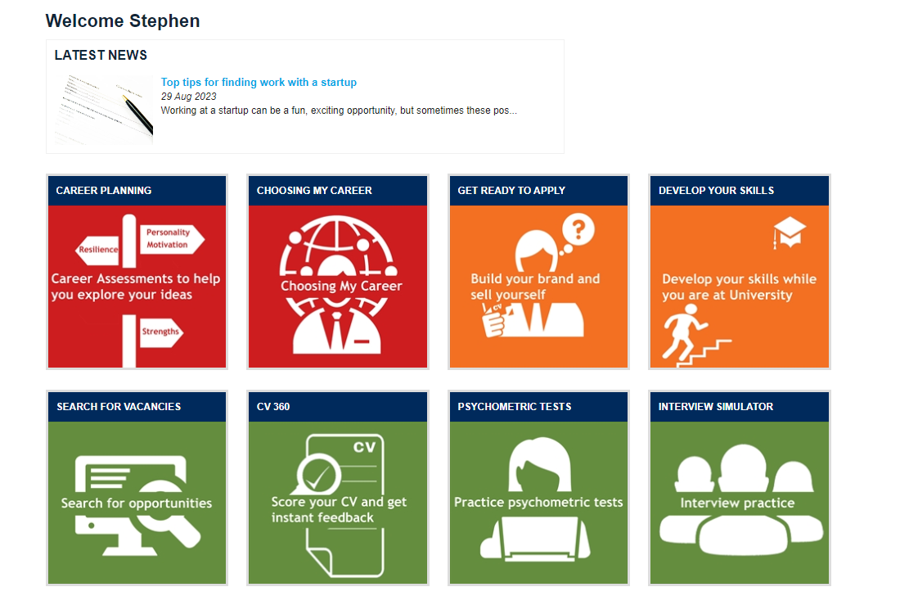
Resources – Careers Toolkit
https://www.abintegro.com/welcome/Strathclyde-University

Slide 7
THE SCOTTISH GRADUATE FAIR 2023
Date: 27 and 28 September 2023
Time: 11am to 4pm (each day)
Location: Technology and Innovation Centre (TIC), 99 George Street, Glasgow, G1 1RD
The Scottish Graduate Fair is the highlight of the recruitment season.
Now in its 34th year, it is the biggest graduate, postgraduate and internship recruitment event in Scotland attracting students and graduates of all disciplines and a variety of graduate employers and postgraduate recruiters.
More information at - www.scottishgraduatefair.org.uk
Scan here to register!
@ScotGradFair
#ScotGradFair23
Free to attend! Open to all Students & Graduates from all Universities.

Slide 8
TECHNOLOGY FAIR 2023
Careers & Employability Service
Date: Thursday 9th November
Time: 1pm - 4pm
Location: Technology & Innovation Centre (TIC),
99 George Street, Glasgow, G1 1RD
The Technology Fair provides you with the opportunity to meet the leading tech firms who are looking to recruit from the University of Strathclyde and are offering internships and graduate roles.
This event is open to all students considering a career in IT and the tech industry.
Register NOW to attend!

Slide 9
Careers Service Support
Guidance Appointment 30 mins Book with Reception
Practice Interview 45 mins Book with Reception
CV Check 20 mins Book Online
Employer Events 1-2 hrs Book Online
Briefing Sessions 30 mins Book Online
Reception: Careers Service, L4, Student Experience, Learning & Teaching Building. Email yourcareer@strath.ac.uk

