Slide 1
CS 408 Individual Project
Alex Coddington
Alex.Coddington@strath.ac.uk
LT1410

Slide 2
CS 408 Individual Project
This is a significant independent project
40-credit class = 400 nominal hours of work
You need to pass this class (40% or more) in order to qualify for the award of BSc Honours or MEng
For BSc Honours, the mark for your project will normally contribute towards 25% of your overall mark

Slide 3
Timetable of Key Dates
Dates | Activities or Deliverables
S1: Week 0: Monday 11/09/2023 | Project offerings available
S1: Week 1: Friday 22/09/2023, 12pm | Project choices due
S1: Week 2: Friday 29/09/2023 | Project allocation available
S1: Week 10: Friday 24/11/2023 | Project Progress Report due (12 pages)
S2: Week 0: Thursday 11/01/2024 | Project Progress Presentation (10 slides)
S2: Week 11: Tuesday 26/03/2024 | Final Project Submission
S2: Week 11: Thursday 28/03/2024 | Project Demo Day

Slide 4
CS408 Individual Project MyPlace
Please read the CS408 Individual Project Information and Guidelines
How to choose your project
How to write your project progress report
How to prepare your project progress demonstration
How to write your final project report
What you need to do for the final project demonstration
And details of how your project is assessed and the marking scheme!!

Slide 5
CS408 Support and Guidance
Read the CS408 Myplace page
CS408 Information and Guidelines
Videos, articles, etc.
Two lectures
Ethics, 25/10/2023 in RC512
Usability Studies, 22/11/2023 in RC512
Academic Library Skills
Learner Support Services

Slide 6
Choosing Your Project
Choose from the project themes suggested by staff
http://classes.myplace.strath.ac.uk/mod/page/view.php?id=772439

Slide 7
Rules for Choosing your Project
You will be expected to choose six projects from those listed on the project offerings page
You must not choose projects if they are inappropriate for your degree
E.g. Projects based on topics taught in classes which you haven’t taken
You must list no more than two projects suggested by the same member of staff.
Your project choices should be submitted in order of preference.
If you do not comply with the above, you may be allocated a project at random.
https://local.cis.strath.ac.uk/wp/extras/projects/CS408.php

Slide 8
Advice and Caveats
For each project you choose, you are strongly advised to discuss it with the member of staff that suggested it. The reason for this is that your understanding of a project proposal may not be what the supervisor had in mind.
There is no guarantee that the member of staff that suggested a project will end up supervising that project and although reasonable effort will be made to ensure that you are allocated one of your chosen projects, this cannot be guaranteed.

Slide 9
Choosing Your Project
You must take this seriously and pick 6 projects that you would be happy to take
You will not get a second chance after the projects have been allocated

Slide 10
Project Management is about risk
In any endeavour, you manage risk
E.g., Going sailing – wear a life jacket
If you nurture the skills I’m going to talk about (and avoid the pitfalls), you minimize your chances of
Having a great project experience
A high project mark

Slide 11
Skills you will learn/need for your project
Time Management
Professionalism
Perseverance

Slide 12
Time Management
Reality Check
Time flies; Project work doesn’t
There will always be other deadlines to distract
Christmas fever looms all December
When you look again … January will be here and panic might set in
If you panic, you can’t think straight, and that will slow you down even further

Slide 13
So what should you do?
Take time to plan
Yes, I know, it’s boring
But it really pays dividends
Create a spreadsheet and record all the activities you need to do along with a deadline for each
Build in some flexibility AND rest times (Christmas)
Check things off (great!) and know if you’re lapsing

Slide 14
Professionalism
Highly valued in industry
Punctuality is important
Lateness creates a bad impression
If you have a problem, let your supervisor know
Preparedness
Go to meetings with some discussion points and questions

Slide 15
Professionalism
Preparedness
If you do your time management properly, you can speak to your supervisor about potential issues in progressing
Communication
Let your supervisor know if you can’t make a meeting/ if you are ill/ If you have a flood at home/anything that will impact your project

Slide 16
Perseverance
You will hit snags
This builds problem-solving skills
Pushing through these will show your ability to overcome adversity
Your supervisor is there to help you

Slide 17
Perseverance
Write
Write from day 1
Add to your dissertation every time you complete a phase of your project
Lit Review
Requirements Gathering etc.
Write early, write often, return to polish

Slide 18
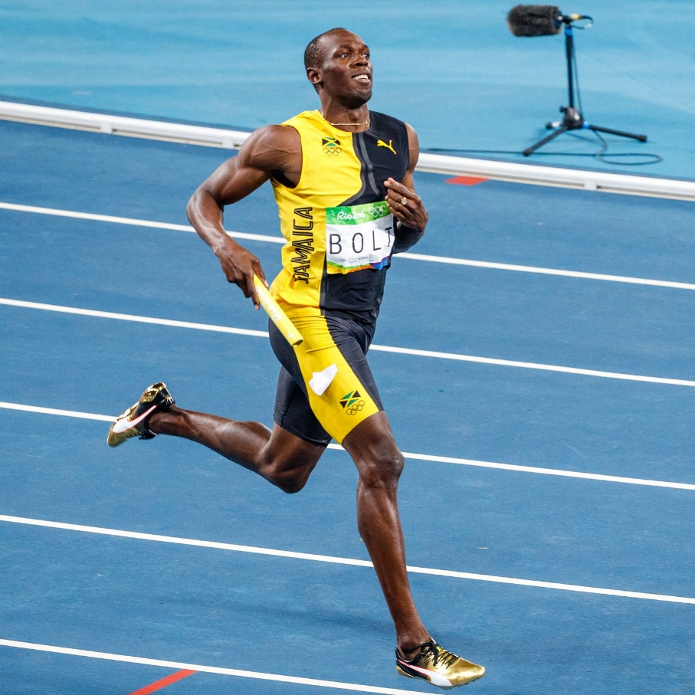
Project Work …

Slide 19
Your dissertation
There is a Word and LateX template for you to use on MyPlace
Most important parts
Structure, structure, structure
Polishing and Refining take time
A dissertation is NOT an elevator pitch

Slide 20
 | Software Development Based | Experimentation-based with Significant Software Development | Experimentation-based
Project progress presentation | 10% | 10% | 10%
Product:
Implementation (including documentation as this indicates maintainability) | 25 | 20 | 10
Verification and Validation | 10 | 5 | 5
Product Total: | 35% | 25% | 15%
Process
Background, methodology, analysis and documentation | 15 | 20 | 20
Design | 10 | 5 | 5
Process Total | 25% | 25% | 25%
Results and Evaluation
 | 15% | 25% | 35%
Report Presentation
 | 10% | 10% | 10%
Student Performance
 | 5% | 5% | 5%

Slide 21
Structure
Abstract: Elevator pitch
Introduction: Runway
Taking Off: Tell the reader a story
Landing: Discussion & Conclusion
Flight Experience: quality of writing and referencing

Slide 22
Dissertation Length
A project report should not exceed 30 pages of main text
1.5 spacing
Use sans serif font 11 point, e.g. Calibri with default margins
A4 size with 1 inch edge on every side
Plus title and abstract on title page
There is no restriction on the total length including appendices BUT markers are not obliged to read appendices

Slide 23
Your supervisor
Helps and advises
But will not take ownership
They will not debug your code
They will not correct spelling errors in your dissertation
They WANT you to succeed
They WANT you to get a high grade
The onus is on you

Slide 24
Email Protocol
If you want to arrange a meeting
Send an email
State your availability (when you’re not in lectures/labs)
Regular Project Meeting/Need to report a personal issue/urgency
If you’re sending chapters
Ask your supervisor which format they would prefer
Don’t expect feedback the next day

Slide 25
Project Choices
You need to submit your project choices by 12pm, 22/09/2022

Slide 26
Any Questions?

